Slide 1

Skin disease Detection

Slide 2
Problem statement
Health care system in India-huge challenge
Ratio of available doctors to patients is 1:10000.
Cost of healthcare increasing
Reach to common man

Slide 3
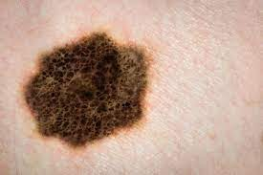
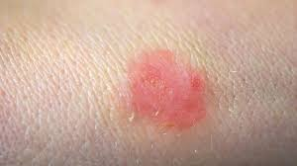
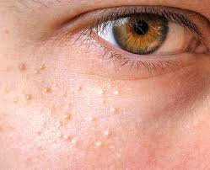
Project Goal
To build an application where scanned image/live image is classified into particular disease and recommend the cure accordingly.

Slide 4
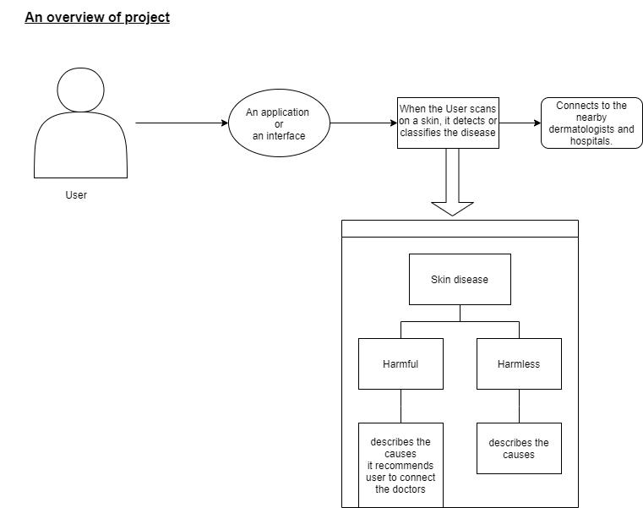
Project Flow

Slide 5
Benefits
Detection at early stages would heal better.
Easy to classify the disease using ML and DL
Detection, classification, and prediction of skin disease would make doctors treat it easily.
Low cost solutions
Reach to even villages where health care facilities are less.

Slide 6
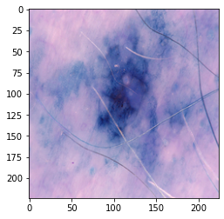
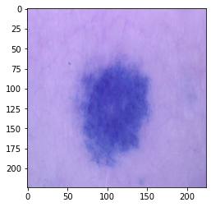
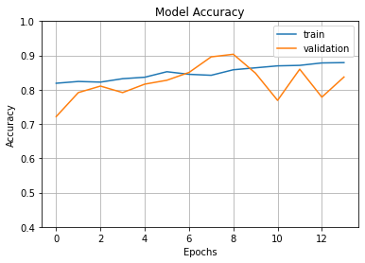
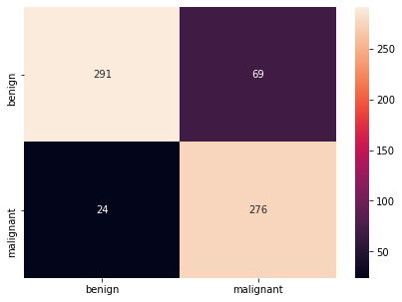
Skin Disease Detection
Data taken from Kaggle
Train data:2637 images-1197 mal,1440 benign
Test data:660-300 mal,360 benign
U-NET style model with MobileNet performed the best with 84% accuracy
Malignent
Benign

Slide 7
Acne Detection and Recommendation
8th most common disease in the world
80% people affected by acne between onset of puberty to 30 years of age
Can lead to emotional and psychological issues
By 2026, people affected will reach up to 23 million in India
Acne market has grown from USD48 million in 2012 to USD78.5 million in 2016 in India.

Slide 8
Steps
Identifying the data of face with acne into different clusters and classifying them into different segments
Using one eye face detection model, crop the affected area and make bounding box on the same.
Classify the affected part with help of deep learning models
Take the live image of customer , classify the image and show the affected parts
Recommend the cure accordingly

Slide 9
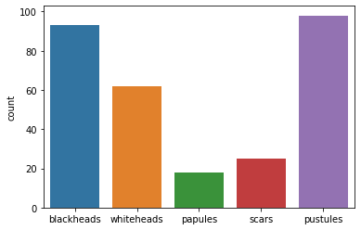
Identifying the data
Gathered 296 images with 5 classes
Classes:
Open comedo (black head)-92 images
Closed comedo (white head)-62 images
Papules -19 images
scars-25 images
Pustules-98 images

Slide 10
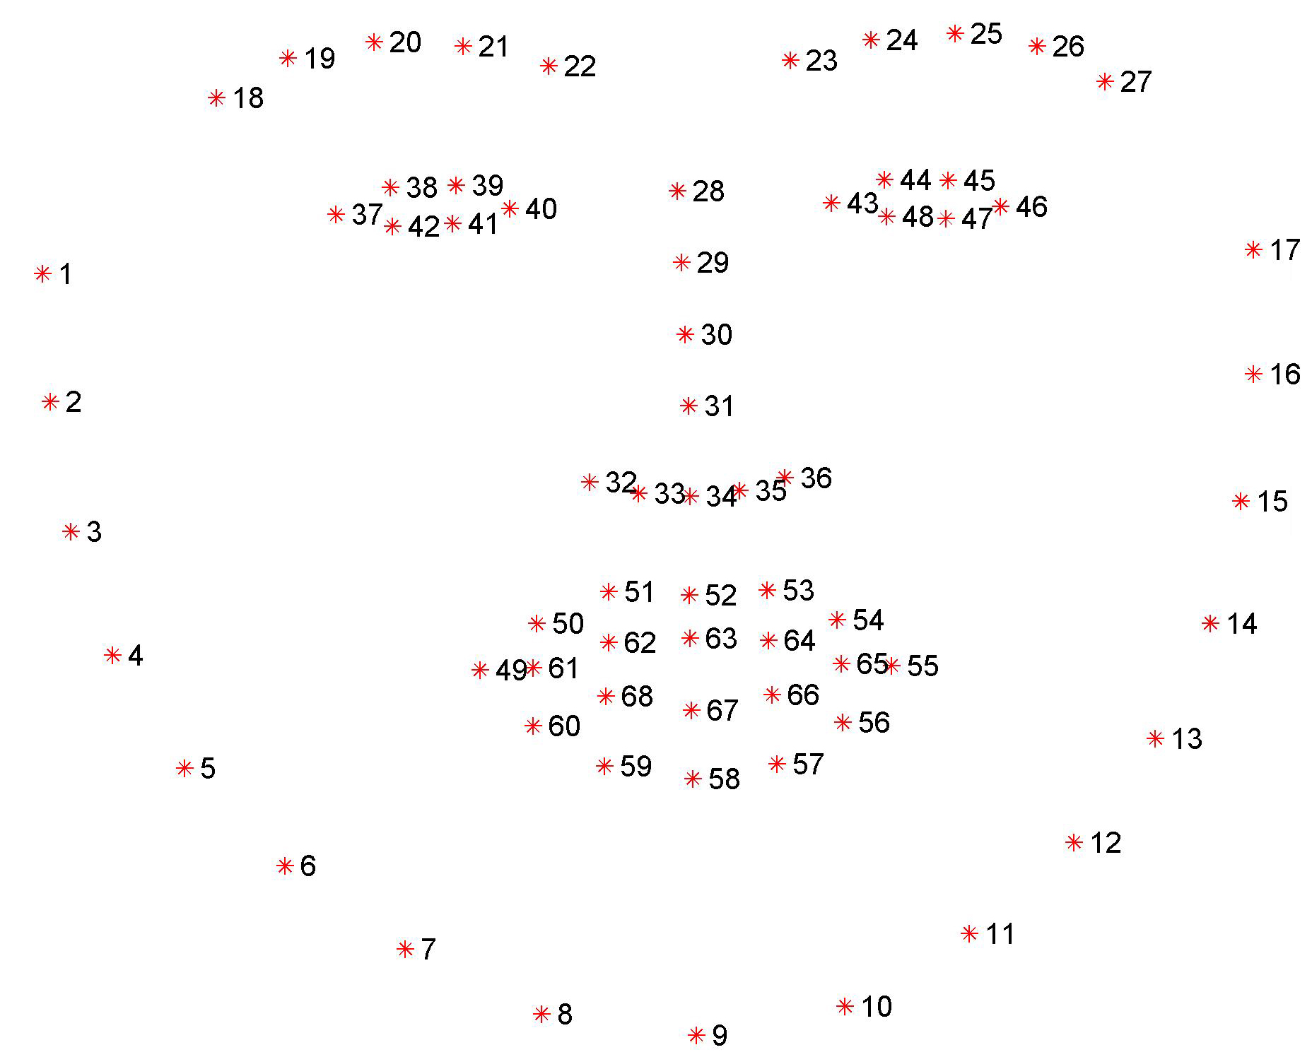
Cropping the image for affected area
Used shape predictor 68 landmark model
FACE_POINTS = list(range(17, 68))
MOUTH_POINTS = list(range(48, 61))
RIGHT_BROW_POINTS = list(range(17, 22))
LEFT_BROW_POINTS = list(range(22, 27))
RIGHT_EYE_POINTS = list(range(36, 42))
LEFT_EYE_POINTS = list(range(42, 48))
NOSE_POINTS = list(range(27, 35))
JAW_POINTS = list(range(0, 17))
Cropped affected area from right cheek, left cheek, forehead and jaw line

Slide 11
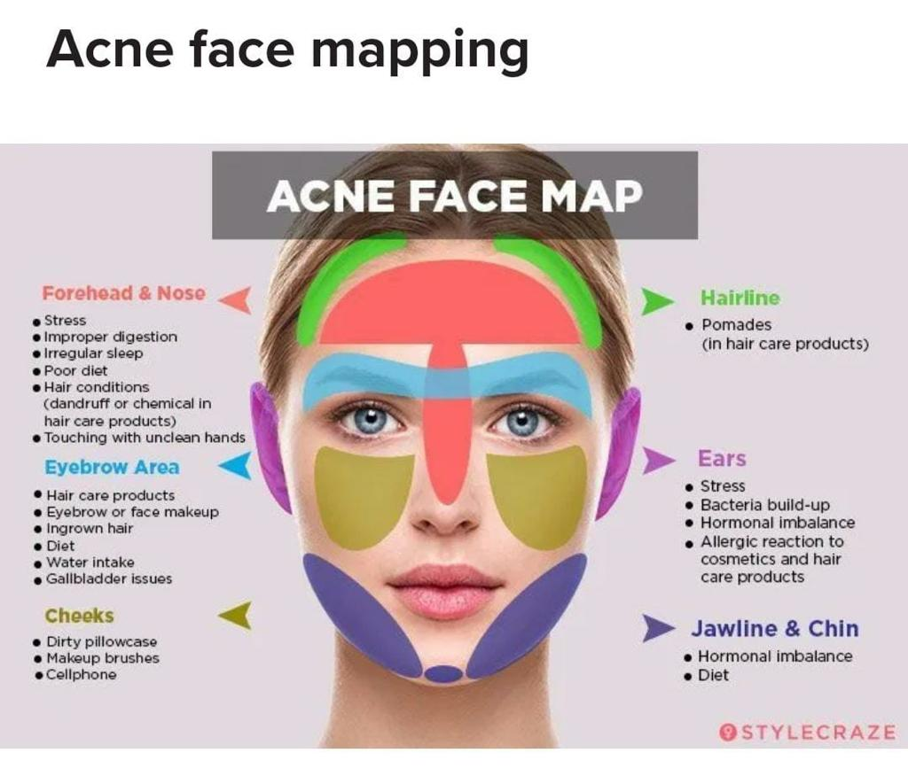
End product

Slide 12
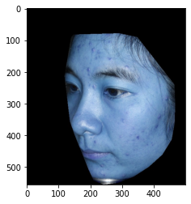
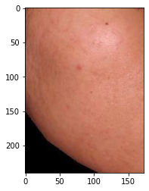
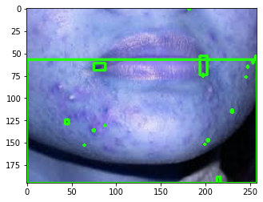
Image with bounding box
Original image
Cropped image

Slide 13
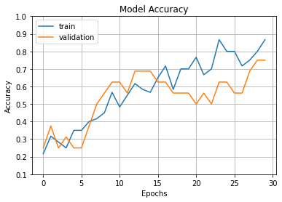
Classifying using Deep learning models
Model accuracy with validation data with Vgg16 model
Test Accuracy: 70-75%

Slide 14
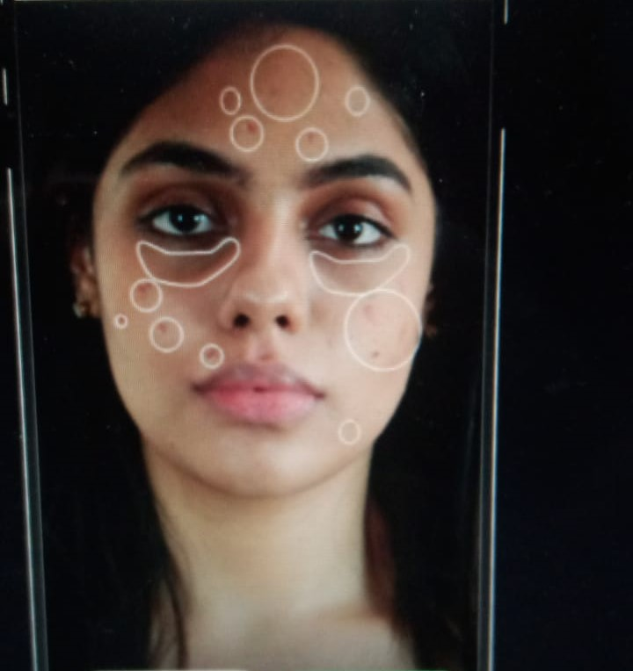
Taking the live image
We are working on taking live image from the customer suffering from skin disease and acne and classifying accordingly. The Accuracy is between 80% and 90%
Tested live image of one of employees

Slide 15
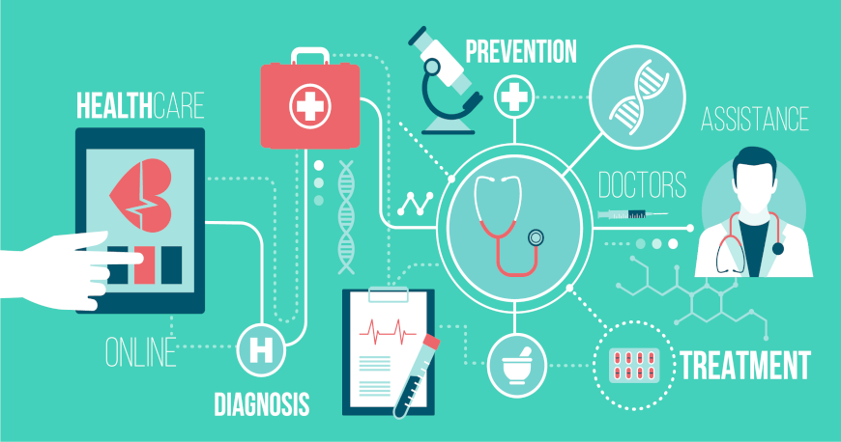
CONCLUSION
This application would be an interface between user and physicians.
It would be feasible for people to get to know about the skin disease.

